Slide 1
8254 - Programmable interval timer

Slide 2
8254 is a device designed to solve the timing control problems in a microprocessor
It has 3 independent counters, each capable of handling clock inputs up to 10 MHz, and size of each counter is 16 bit.
It operates in +5V regulated power supply and has 24 pin signals.
All modes are software programmable

Slide 3
8254 counters
3, 16-bit programmable counters capable of counting in binary as well as BCD
Maximum allowable frequency is 10MHz.
Each timer has a clk input, gate input G and an output.

Slide 4
Applications –
To generate an accurate time delay
As an event counter
Square wave generator
Rate generator
Digital one shot

Slide 5
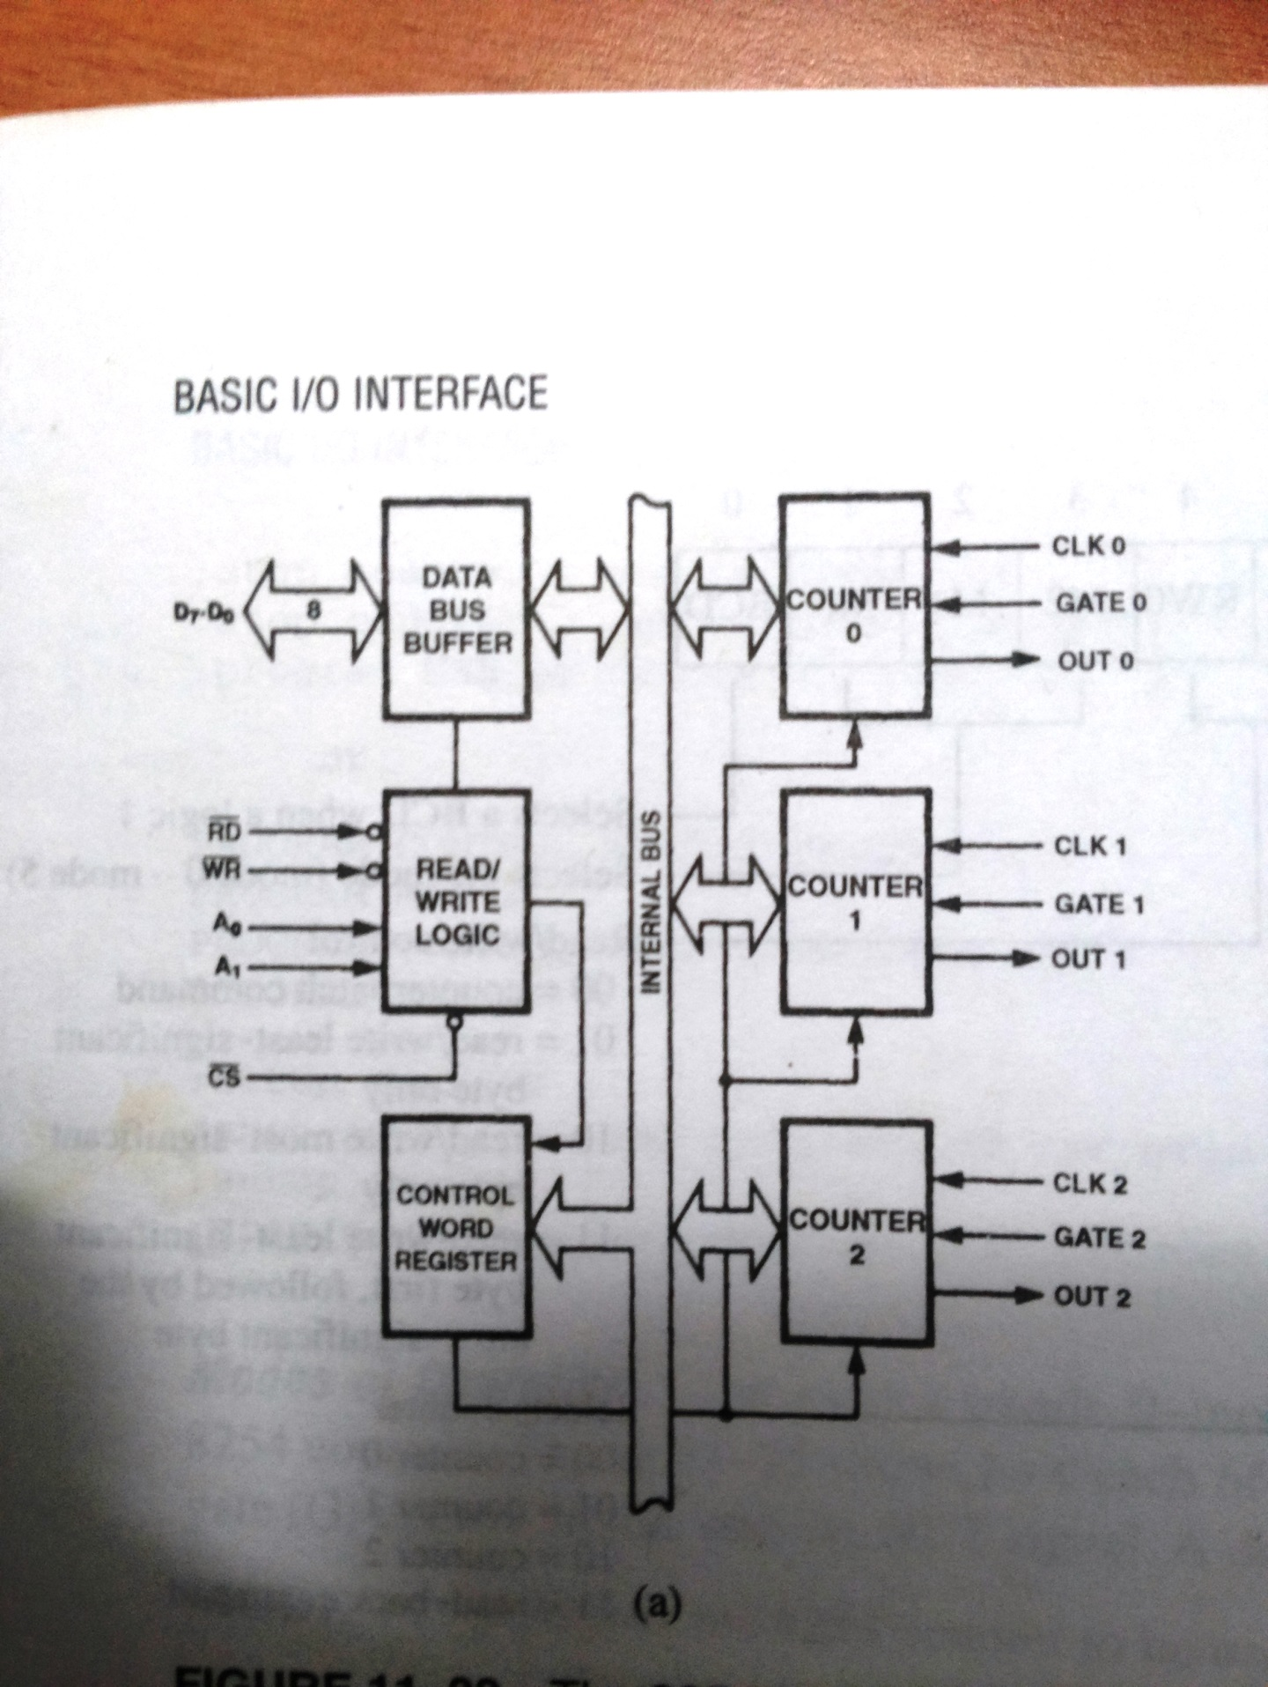
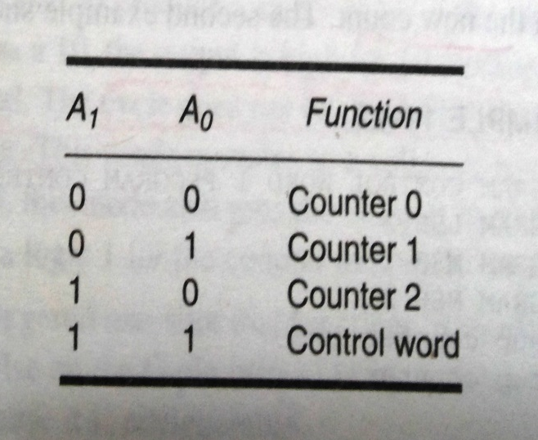
8254 - Programmable interval timer

Slide 6
It has 3 counters each with two inputs (Clock and Gate) and one output.
Gate is used to enable or disable counting. When any value of count is loaded and value of gate is set(1), after every step value of count is decremented by 1 until it becomes zero.
Depending upon the value of CS, A1, and A0 we can determine the addresses of the selected counter.

Slide 7
A
CS | A1 | A0 | SELECTION
0 | 0 | 0 | C0
0 | 0 | 1 | C1
0 | 1 | 0 | C2
0 | 1 | 1 | Control Register

Slide 8
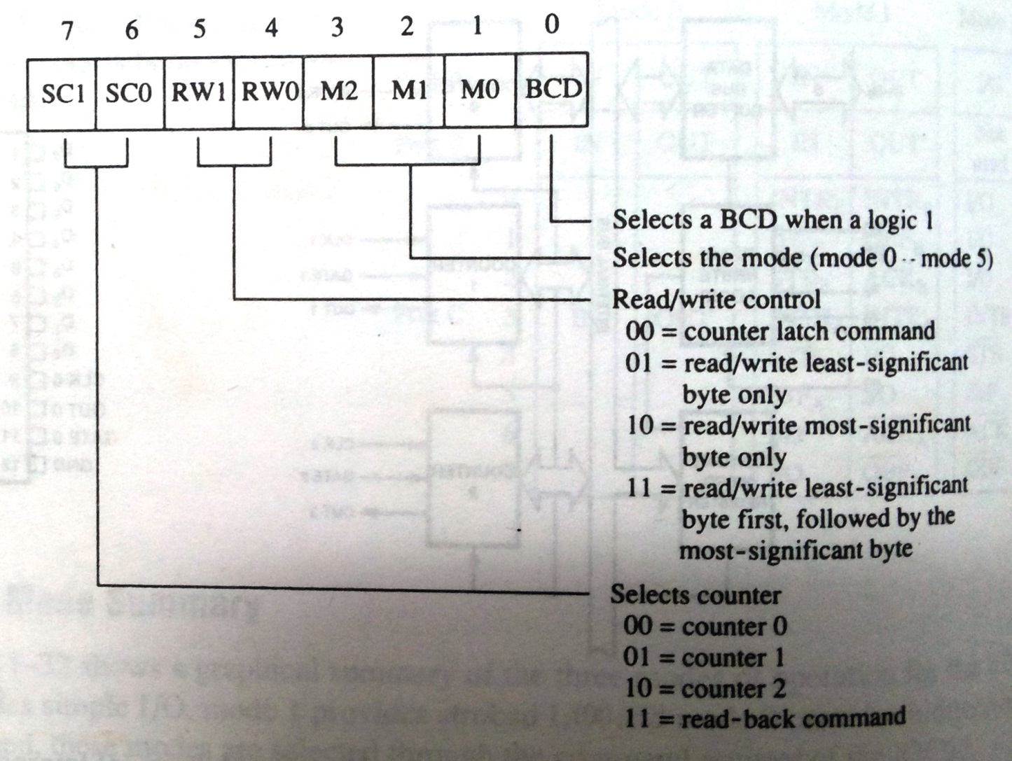
CONTROL WORD FOR 8254

Slide 9
MODE 0: INTERRUPT ON TERMINAL COUNT
Mode 0 is typically used for event counting.
After the Control Word is written, OUT is initially low, and will remain low until the Counter reaches zero
. OUT then goes high and remains high until a new count or a new Mode 0 Control Word is written into the Counter.

Slide 10
After the Control Word and initial count are written to a Counter, the initial count will be loaded on the next CLK pulse.
This CLK pulse does not decrement the count, so for an initial count of N, OUT does not go high until N + 1 CLK pulses after the initial count is written

Slide 11
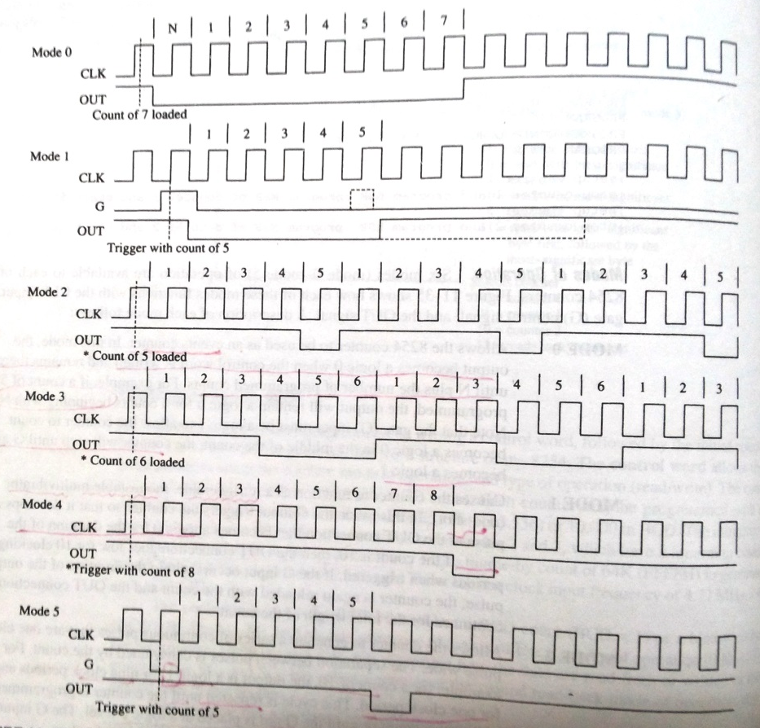
Interrupt on terminal Count
(G=1 THROUGHOUT)
Hardware retriggerable
Timed Interrupt Generator
(G=1 THROUGHOUT)
Square wave
Software Triggered Strobe
Hardware triggered strobe

Slide 12
MODE 1: HARDWARE RETRIGGERABLE ONE-SHOT
OUT will be initially high. OUT will go low on the CLK pulse following a trigger to begin the one-shot pulse, and will remain low until the Counter reaches zero

Slide 13
Interrupt on terminal Count
(G=1 THROUGHOUT)
Hardware retriggerable
Timed Interrupt Generator
(G=1 THROUGHOUT)
Square wave
Software Triggered Strobe
Hardware triggered strobe

Slide 14
Mode 2 (Rate Generator) – Initially value of OUT is low.
When counting is enabled, it becomes high and this process repeats periodically.
Value of count = Input Frequency / Output Frequency. This mode works as a frequency divider.

Slide 15
Interrupt on terminal Count
(G=1 THROUGHOUT)
Hardware retriggerable
Timed Interrupt Generator
(G=1 THROUGHOUT)
Square wave
Software Triggered Strobe
Hardware triggered strobe

Slide 16
Mode 3 (Square Wave Generator) – Counting is enabled when GATE = 1 and disabled when GATE = 0.
This mode is used to generate square waveform and time period (equal to count) is generated.
If N is count and is even then ontime of wave = N/2 and offtime = N/2 If N is odd the ontime = (N + 1) / 2 and offtime = (N – 1) / 2

Slide 17
Interrupt on terminal Count
(G=1 THROUGHOUT)
Hardware retriggerable
Timed Interrupt Generator
(G=1 THROUGHOUT)
Square wave
Software Triggered Strobe
Hardware triggered strobe

Slide 18
Mode 4 (Software Triggered Strobe) – In this mode counting is enabled by using GATE = 1 and disabled by GATE = 0.
Initially value of OUT is high and becomes low when value of count is at last stage.
Count is reloaded again for subsequent clock pulse

Slide 19
Mode 3 (Square Wave Generator) – Counting is enabled when GATE = 1 and disabled when GATE = 0.
This mode is used to generate square waveform and time period (equal to count) is generated.
If N is count and is even then ontime of wave = N/2 and offtime = N/2 If N is odd the ontime = (N + 1) / 2 and offtime = (N – 1) / 2

Slide 20
Interrupt on terminal Count
(G=1 THROUGHOUT)
Hardware retriggerable
Timed Interrupt Generator
(G=1 THROUGHOUT)
Square wave
Software Triggered Strobe
Hardware triggered strobe

Slide 21
Mode 5 (Hardware Triggered Strobe) – OUT will initially be high.
Counting is triggered by a rising edge of GATE.
When the initial count has expired, OUT will go low for one clock pulse and then go high again.
After writing the Control Word and initial count, the counter will not be loaded until the clock pulse after a trigger.

Slide 22
Interrupt on terminal Count
(G=1 THROUGHOUT)
Hardware retriggerable
Timed Interrupt Generator
(G=1 THROUGHOUT)
Square wave
Software Triggered Strobe
Hardware triggered strobe

Slide 23
Write a procedure to generate a 100kHz square wave at OUT0 and a 200kHz continuous pulse at OUT1
Assume 8254 interfaced to 8MHz 8086, address of control word as 706H and address of counter0 as 700H, address of counter1 as 702H
Timer_Proc:
MOV DX, 706H
MOV AL, 00110110B ; To program counter0
OUT DX,AL
MOV AL, 01110100B; To program counter1
MOV DX, 700H
MOV DX, 702H
MOV AL, 80 ; Load value to counter0
OUT DX, AL
MOV AL,0
OUT DX,AL

Slide 24
MOV DX, 702H
MOV AL, 40 ; Load value to counter0
OUT DX, AL
MOV AL,0
OUT DX,AL
RET

